Slide 1


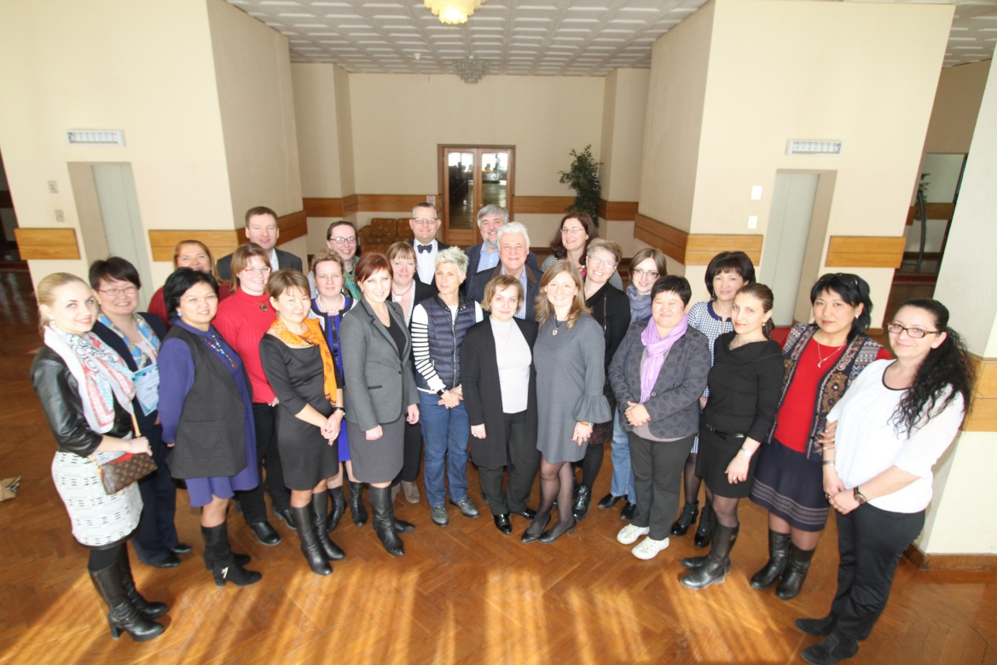


EurDiQ project implementation report
Financial University
Riga, 27.02.2019

Slide 2
EurDiQ project: accomplished activities
Analytical report on the tendencies of the tourism market development and employers’ needs has been completed.
OS “Destination development” proposal having both national and EU values has been developed
Seminar “Tourism occupational standards and qualification framework development” has been organized in Moscow in March 2017
Destination development module syllabi has been developed and approved by European experts
Pilot realization of the Destination development module (10 Master level students have successfully accomplished the Module)
Curriculum and program guide book have been jointly developed (FU, RSUTS, DSTU, LMU)
Developing and uploading of distance learning materials (MOODLE)
Dissemination activities

Slide 3
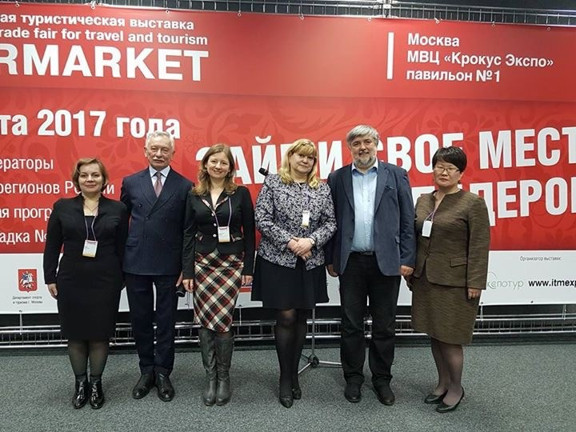
Module Destination Development: Team and Focus
Destination Development Module of the MSc program in Tourism Strategy and Leadership has been developed by professionals of Financial University Management and Tourism Departments:
Olga Subanova
Tatiana Rozanova
Sergei Ilkevich
Destination Development Module Development:
Learning outcomes (both program and module levels) centered approach
Focus on both national and EU values
New methodological, didactical and filed of study related tendencies and approaches were applied within the Module development (jointly with Unic)

Slide 4

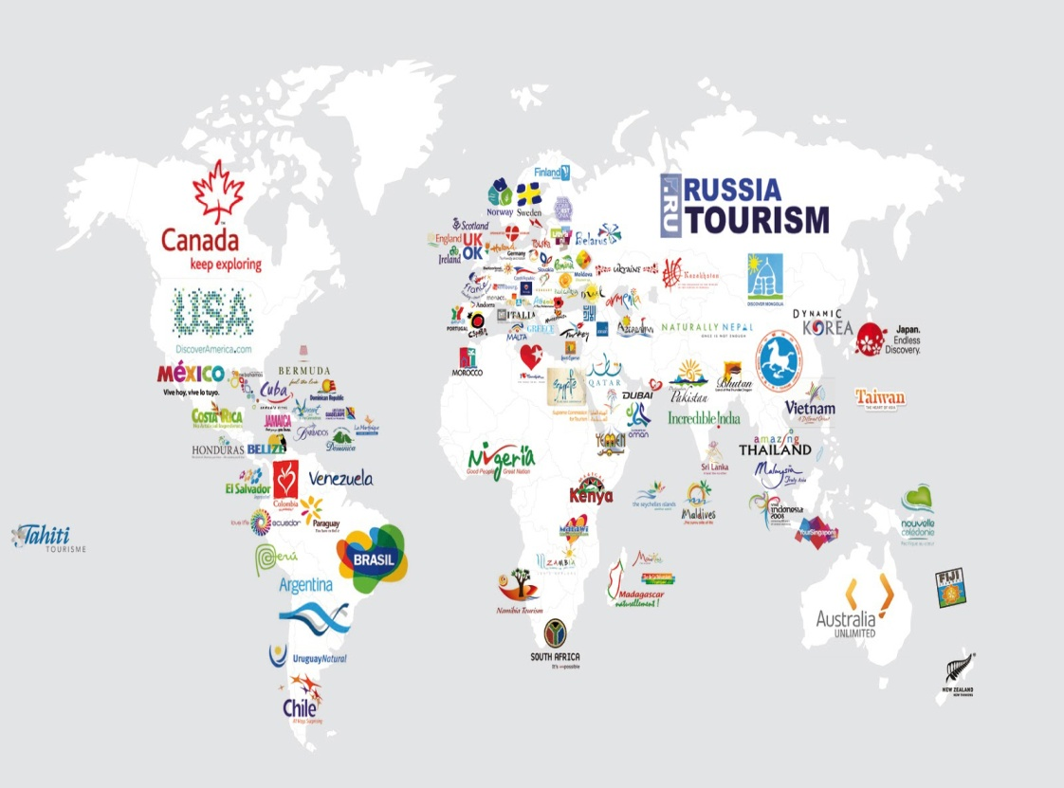
Module general objectives and priority
The main objectives of the course are to broaden students’ understanding of modern theoretical concepts of destination governance and to provide a systemic point of view in destination development. Through project team work, class discussions, course readings students will develop competencies in destination development.
Critical thinking skills development through practical case studies and project work activities

Slide 5
Module Learning Outcomes
After completion of the course students are expected to be able to:
Analyse a range of complex tourist destination management situations and create high quality solutions including destination product portfolio.
Collect data and identify key factors in destination development, audit and evaluate potential of sustainable development of a tourism destination.
Consult and present well-structured arguments for local, regional and federal organizations related to destination development master plans, strategies and policies.

Slide 6
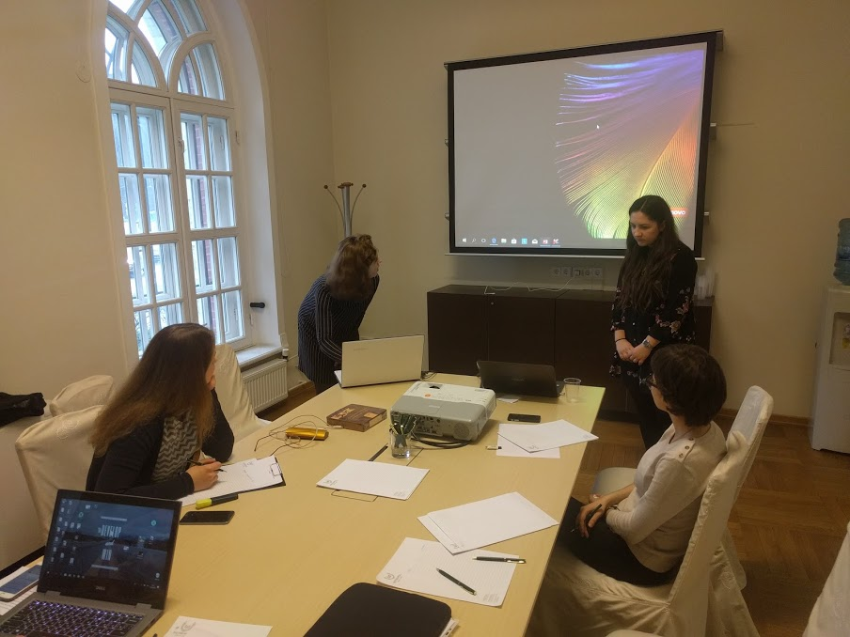
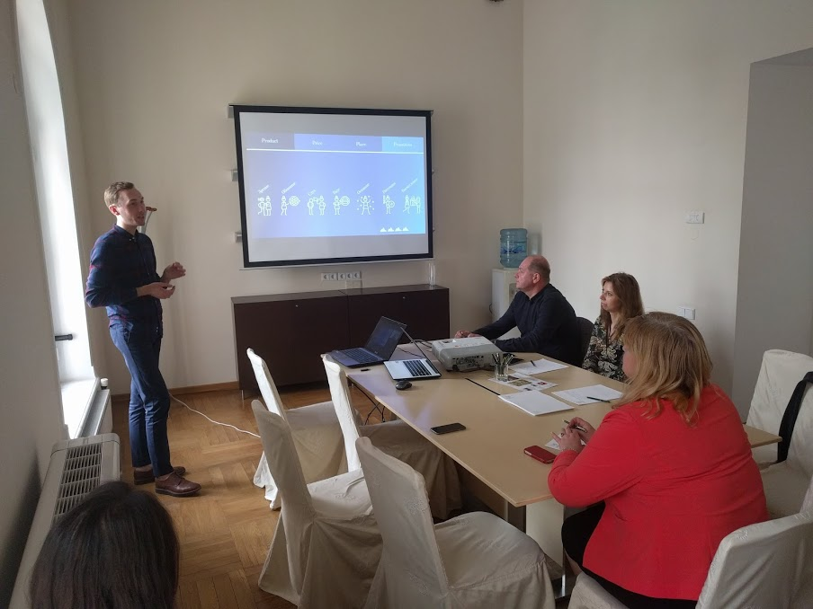
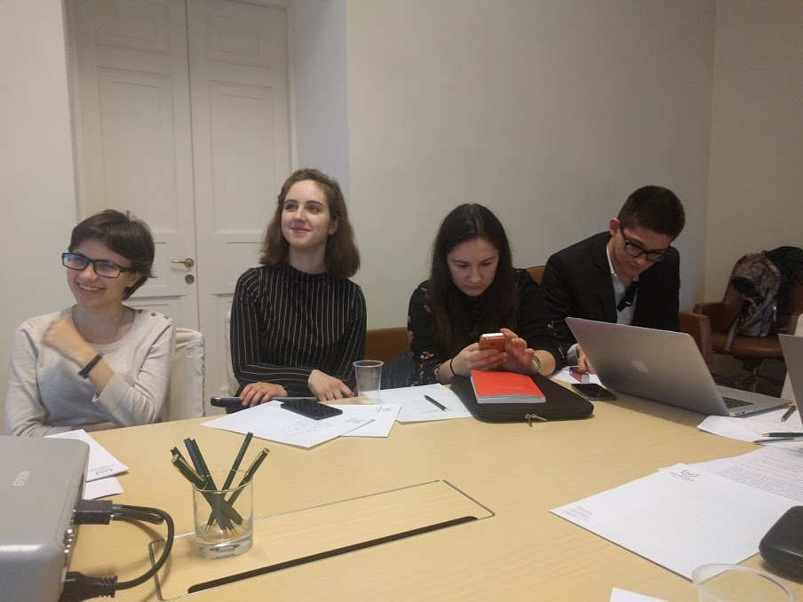
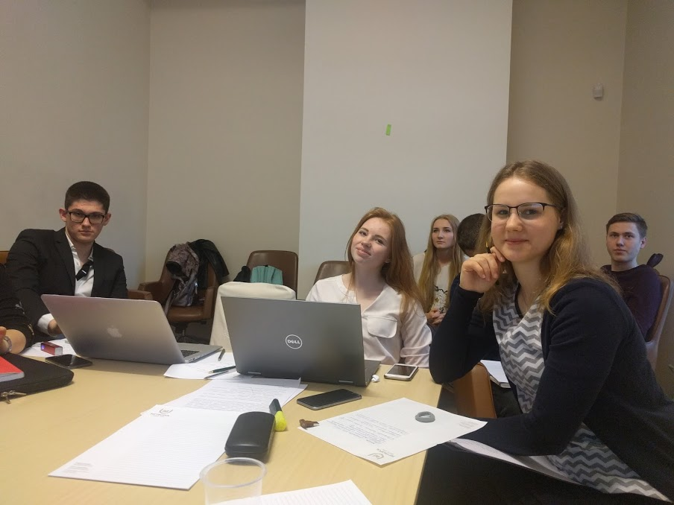
Module Piloting
Schegolgov Yury has conducted the pilot Destination Development Module for the Master level students.
After module completion students presented the results of project work aimed at proposing solutions to increase the attractiveness and competitiveness of chosen touristic destination (including small towns)

Slide 7
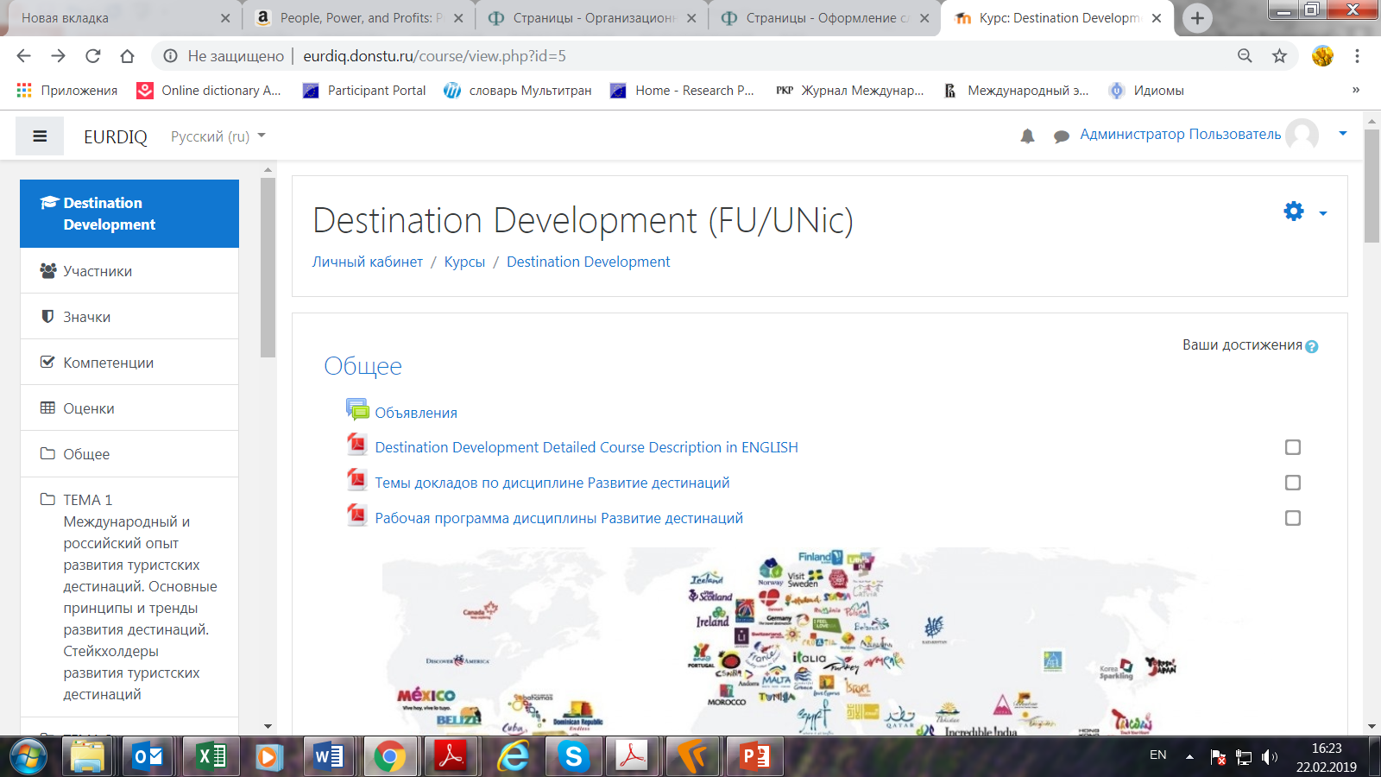
Distance Learning Materials
Module distance learning materials were developed and uploaded to the project web site

Slide 8
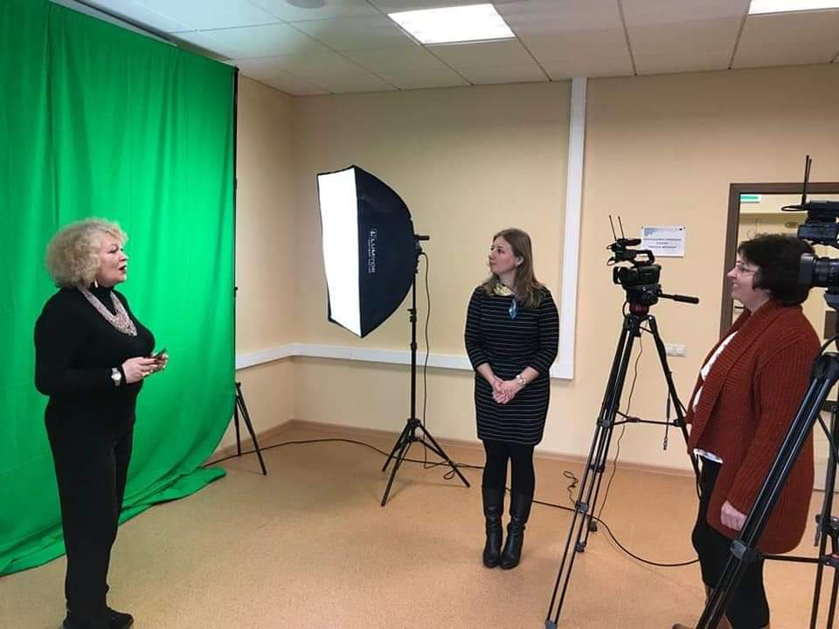
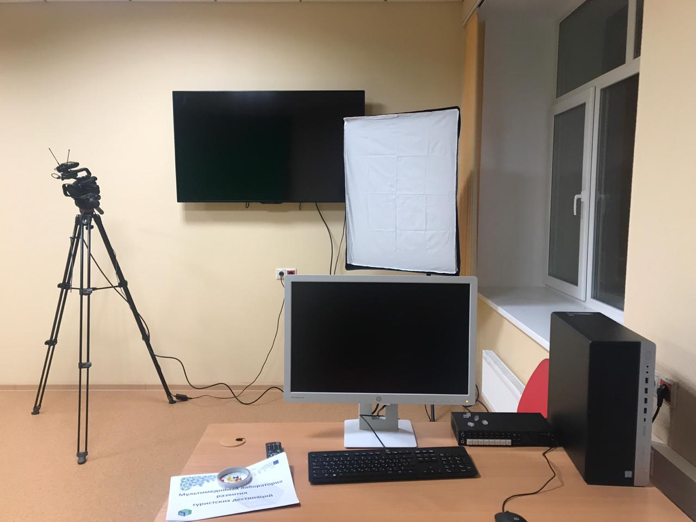
Multimedia learning laboratory
Destination Development
Multimedia Laboratory “Destination Development” will become the center for development of digital learning and study materials
Multimedia Lab will be used for further realization of online joint program
Multimedia Lab is a study lab for students where they can prepare the digital and visual tools for marketing touristic territories
.

Slide 9
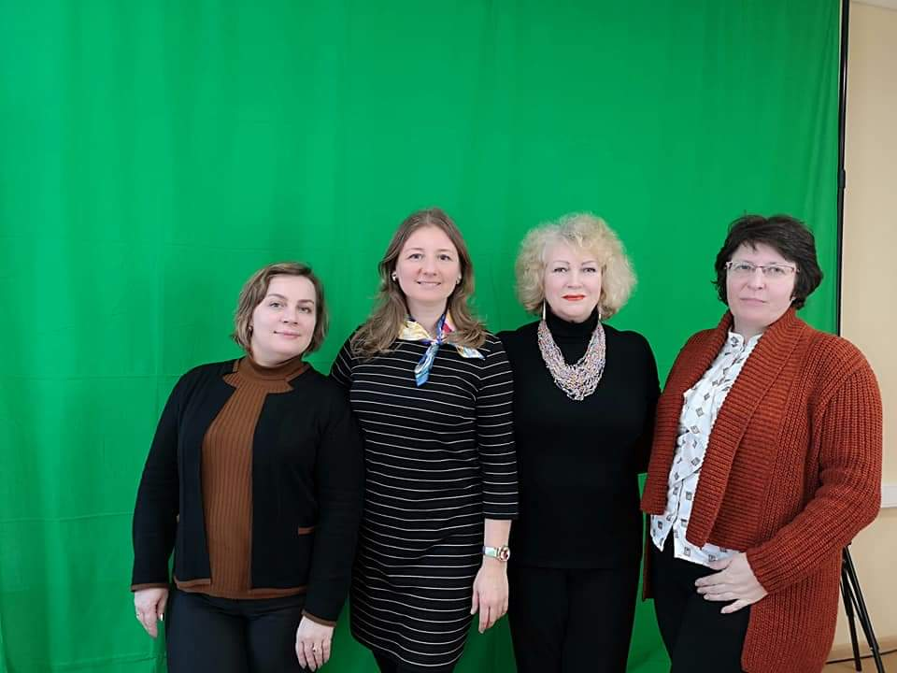
Thank you, colleagues, for joint work and creation!
.

